Slide 1


Elevators
April 2025

Slide 2
Elevator Driving Mechanisms
MR and MRL

Slide 3
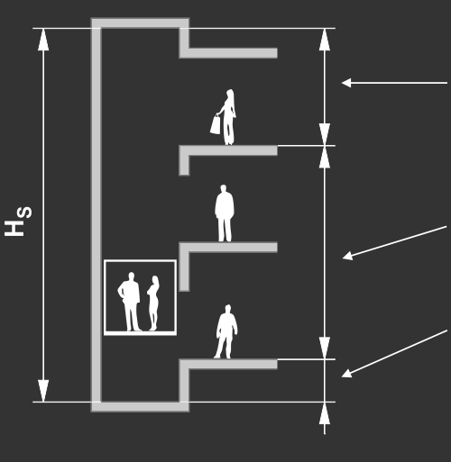
Overhead
Headroom: a part of the shaft between the level of the highest stop and the shaft’s ceiling.
Travel: the length of the cabin’s travel between level of the lowest and the highest stop.
Pit: a part of the shaft below level of the lowest stop.
Total shaft height Hs = Pit + Travel + Overhead
Total Travel
Pit Depth

Slide 4
Elevator Driving Mechanisms
Hydraulic
Traction

Slide 5
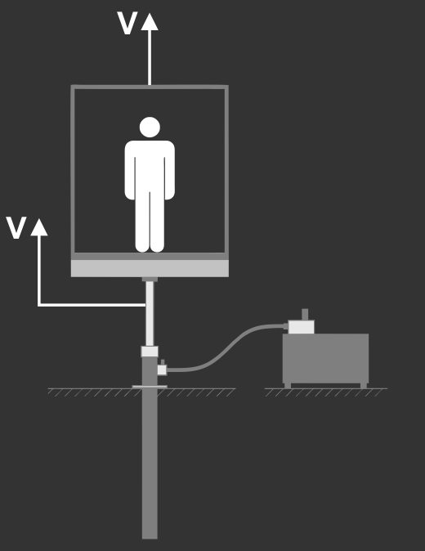
Hydraulic – borehole
In hydraulic elevators with a "bore hole" design, a hydraulic cylinder (jack) is placed in a drilled hole in the ground, directly beneath the elevator car.

Slide 6
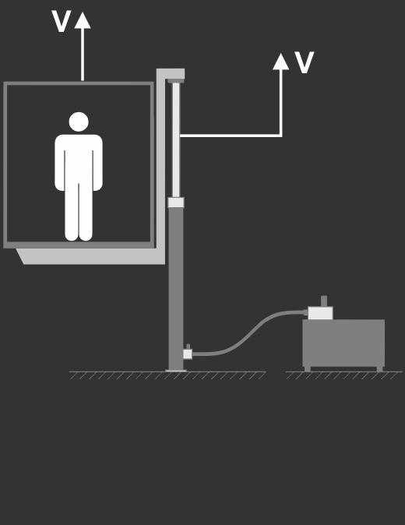
Hydraulic – Side Mount
In this arrangement the hydraulic jack picks up the car frame at the top.

Slide 7
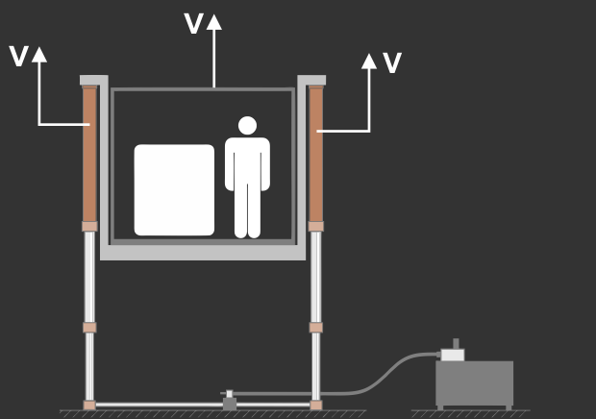
Hydraulic – twin jacks
In this arrangement two jacks with synchronized movement are used.
Telescopic jacks are used for higher travel (2-4 stages).

Slide 8
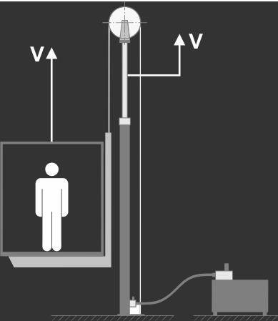
Hydraulic – roped 2:1
In this arrangement a sheave and steel ropes are used to achieve higher travel and higher speed.

Slide 9
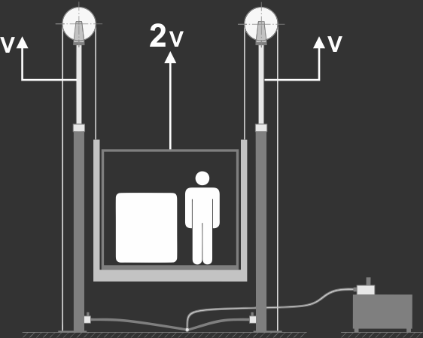
Hydraulic – roped 2:1 – twin jacks
In this arrangement two jacks with synchronized movement are used.

Slide 10
Traction Elevators
Traction elevators
This type of elevators operate via a pulley system, using steel ropes or belts and a counterweight, to move the cabin up and down. There are two types of traction elevators: gearless traction and geared traction. Gearless traction elevators are the more advanced solution, with a wheel attached directly to the motor, and counterweights are used to operate the hoisting system. Geared traction uses a gearbox to turn the hoisting sheave and raise or lower the elevator. These systems are usually slower than gearless systems.
Traction elevators are considered more energy efficient and provide a smoother and quieter ride for passengers. Most modern elevators are gearless traction, which is considered the most energy- and space-efficient solution available.

Slide 11
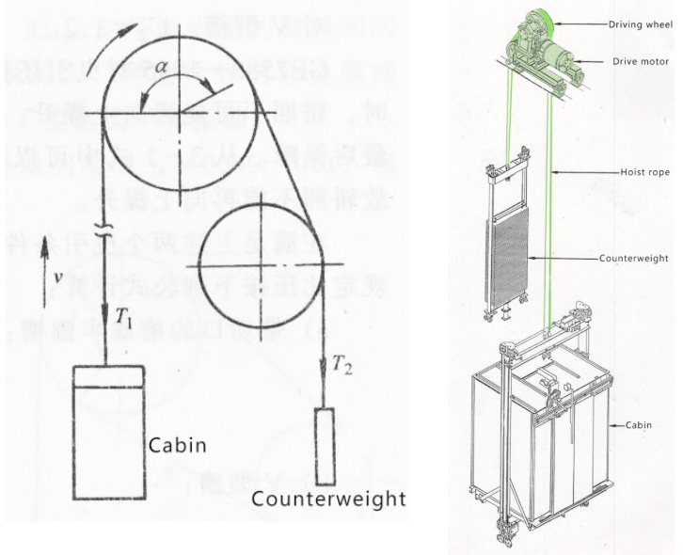
Traction Elevators

Slide 12
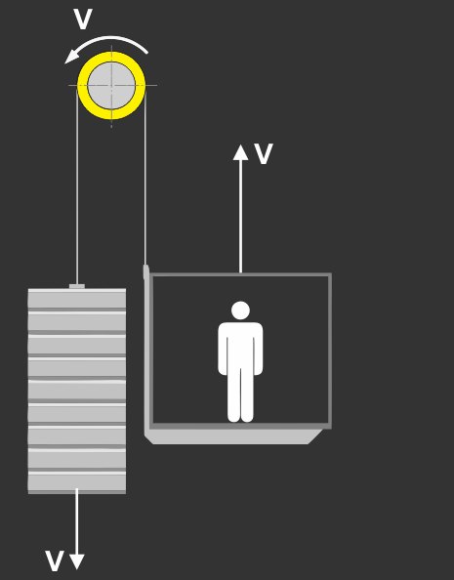
Traction 1:1

Slide 13
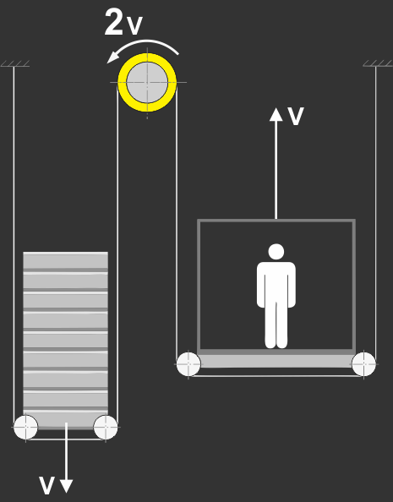
Traction 2:1

Slide 14
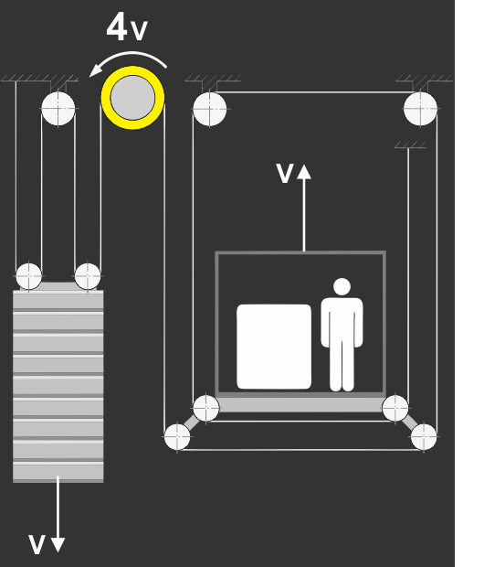
Traction 4:1

Slide 15
MR and MRL
Machine room (MR)
Machine room systems can be either traction or hydraulic. In traction elevators, the machine room is typically located above the hoistway. However, the machine room can also be located at the bottom of the hoistway or in a room adjacent to the elevator bank
Machine room-less (MRL)
Machine room-less systems can be either traction or hydraulic. By incorporating more compact hoisting sheaves, they do not require a machine room to operate the lift, and the machine is located directly in the elevator hoistway. This provides the optimal use of space for the building design.

Slide 16
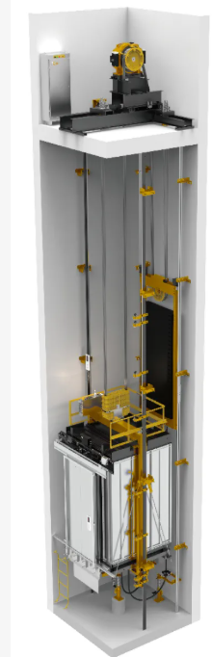
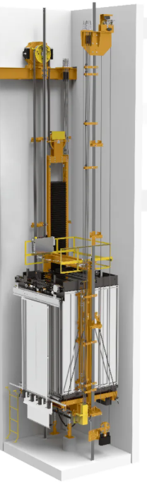
MR and MRL

Slide 17
Modes of Operation

Slide 18
B44 / ASME A17.1
Control Section
Inspection and Test Panel (2.7.6.5 & 2.7.6.5)
Hoistway Access Operation (2.12.7.3)
Emergency Brake (2.19.3)
Ascending Car Overspeed Protection (2.19.1)
Unintended Car Movement Protection (2.19.2)
Terminal Stopping Devices (2.25)
Inspection Operation (2.26.1.4)
Inspection Operation with Open Door Circuits (2.26.1.5)
Operation in Leveling Zone (2.26.1.6)
Monitoring of Faulty Door Contact (2.26.5)
Emergency Operation and Signalling Devices (2.27) – (2.27.3)
Some sections in the code do not apply to us: Example: 2.27.4 / 2.27.5

Slide 19
B44 / ASME A17.1
Control Section
Inspection Operation (2.26.1.4)
Inspection Operation with Open Door Circuits (2.26.1.5)
Operation in Leveling Zone (2.26.1.6)
Monitoring of Faulty Door Contact (2.26.5)
Emergency Operation and Signalling Devices (2.27) – (2.27.3)
Inspection and Test Panel (2.7.6.5 & 2.7.6.5)
Hoistway Access Operation (2.12.7.3)
Emergency Brake (2.19.3)
Ascending Car Overspeed Protection (2.19.1)
Unintended Car Movement Protection (2.19.2)
Terminal Stopping Devices (2.25)
Some sections in the code do not apply to us: Example: 2.27.4 / 2.27.5

Slide 20
